Slide 1
Neural network

Slide 2
Introduction, or how the brain works
Machine learning involves adaptive mechanisms
that enable computers to learn from experience,
learn by example and learn by analogy.
Learning capabilities can improve the performance of an intelligent system over time. The most popular
approaches to machine learning are artificial
neural networks and optimization algorithms.

Slide 3
A neural network can be defined as a model of reasoning based on the human brain.
The brain consists of a densely interconnected set of nerve cells called neurons. These neurons are also known as basic information-processing units.
The human brain incorporates nearly 10 billion neurons and 60 trillion connections, synapses, between them.
By using multiple neurons simultaneously, the brain can perform its functions much faster than the fastest computers in existence today.

Slide 4
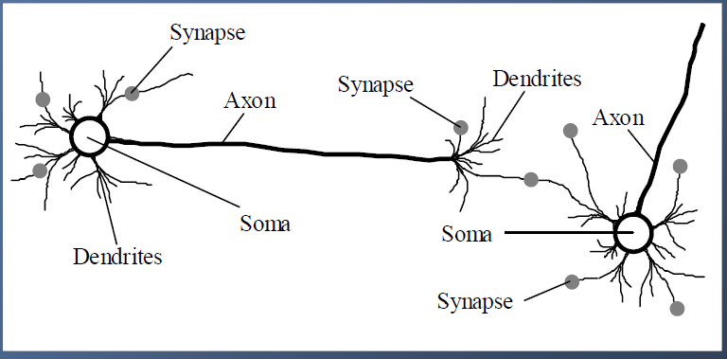
Biological neural network

Slide 5
Each neuron has a very simple structure, but an army of such elements constitutes a tremendous processing power.
A neuron consists of a cell body, soma, a number of fibers called dendrites, and a single long fiber called the axon.
Dendrites are thin and widely branching fibers, reaching out in different directions to make connections to a larger number of cells within the cluster.
Input connection are made from the axons of other cells to the dendrites or directly to the body of the cell. These are known as axondentrititic and axonsomatic synapses.

Slide 6
There is only one axon per neuron.
Axon is a single and long fiber, which transports the output signal of the cell as electrical impulses (action potential) along its length. The end of the axon may divide in many branches, which are then connected to other cells. The branches have the function to fan out the signal to many other inputs.

Slide 7
Our brain can be considered as a highly complex, non-linear and parallel information-processing system.
Information is stored and processed in a neural network simultaneously throughout the whole network, rather than at specific locations. In other words, in neural networks, both data and its processing are global rather than local.
Learning is a fundamental and essential characteristic of biological neural networks. The ease with which they can learn led to attempts to emulate a biological neural network in a computer.

Slide 8
Artificial neural network
An artificial neural network consists of a number of very simple processors, also called neurons, which are analogous to the biological neurons in the brain.
The neurons are connected by weighted links passing signals from one neuron to another.
The output signal is transmitted through the neuron’s outgoing connection. The outgoing connection splits into a number of branches that transmit the same signal. The outgoing branches terminate at the incoming connections of other neurons in the network.

Slide 9
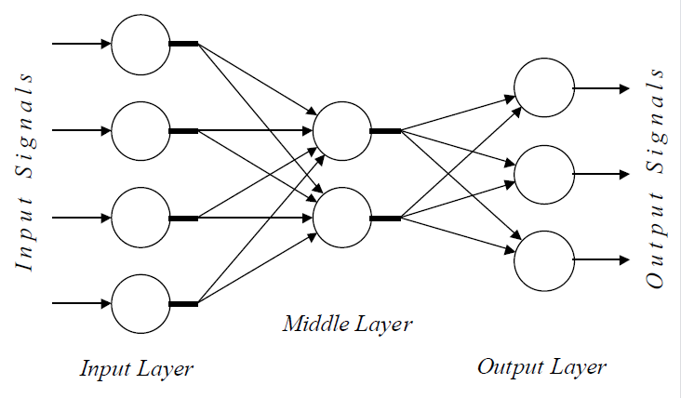
Architecture of a typical artificial neural network

Slide 10
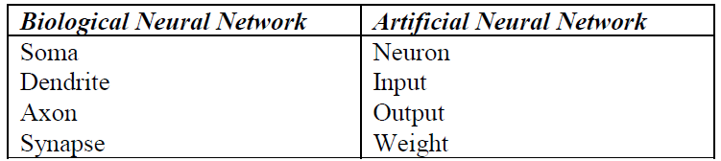
Analogy between biological and artificial neural networks

Slide 11
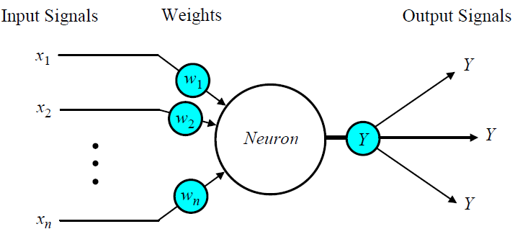
The neuron as a simple computing element
Diagram of a neuron

Slide 12
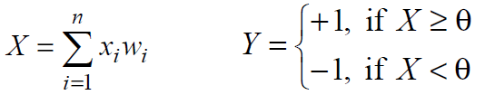
The neuron computes the weighted sum of the input signals and compares the result with a threshold value, ϴ (theta).
If the net input is less than the threshold, the neuron output is –1. But if the net input is greater than or equal to the threshold, the neuron becomes activated and its output attains a value +1.
The neuron uses the following transfer or activation function:
This type of activation function is called a sign function.

Slide 13
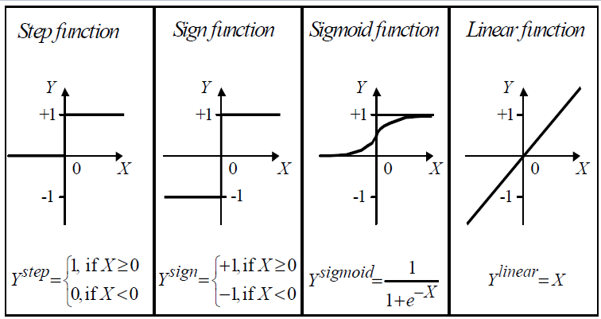
Activation functions of a neuron

Slide 14
Can a single neuron learn a task? -The Perceptron
In 1958, Frank Rosenblatt introduced a training algorithm that provided the first procedure for training a simple ANN: a perceptron.
The perceptron is the simplest form of a neural network. It consists of a single neuron with adjustable synaptic weights and a hard limiter.
The model consists of a linear combiner followed by a hard limiter.
The weighted sum of the inputs is applied to the hard limiter, which produces an output equal to +1 if its input is positive and -1 if it is negative.

Slide 15
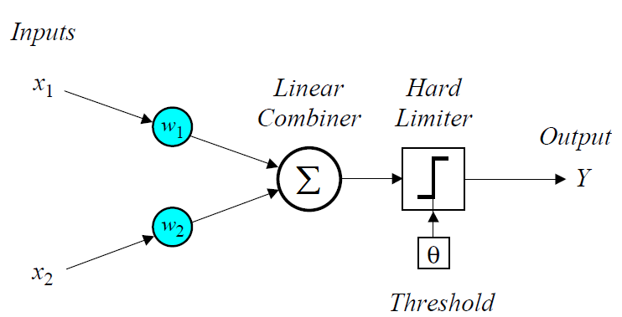
Single-layer two-input perceptron

Slide 16
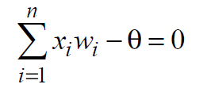
In the case of an elementary perceptron, the n dimensional space is divided by a hyperplane into two decision regions. The hyperplane is defined by the linearly separable function:

Slide 17
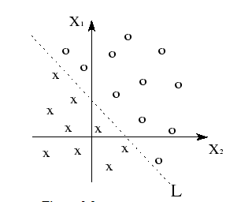
Linear Separability
Consider two-input patterns being classified into two classes.
Each point with either symbol of or represents a pattern with a set of values.
Each pattern is classified into one of two classes. Notice that these classes can be separated with a single line. They are known as linearly separable patterns.
Linear separability refers to the fact that classes of patterns with n-dimensional vector can be separated with a single decision surface.

Slide 18
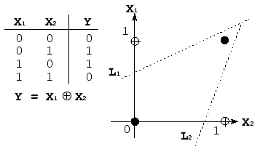
XOR- nonlinearly separable
The two classes must be linearly separable in order for the perceptron network to function correctly. Indeed, this is the main limitation of a single-layer perceptron network.
The most classic example of linearly inseparable pattern is a logical exclusive-OR (XOR) function. Shown in figure is the illustration of XOR function that two classes, 0 for black dot and 1 for white dot, cannot be separated with a single line. The solution seems that patterns of (X₁, X₂) can be logically classified with two lines L₁and and L₂.

Slide 19
How does the perceptron learn its classification tasks?
This is done by making small adjustments in the
weights to reduce the difference between the actual
and desired outputs of the perceptron.
The initial weights are randomly assigned, usually in the range [-0.5, 0.5], and then updated to obtain the output consistent with the training examples.

Slide 20
If at iteration p, the actual output is Y(p) and the desired output is Y_{d} (p), then the error is given by:
e(p) =Y_{d} (p)-Y(p) , where p = 1, 2, 3, . . .
Iteration p here refers to the pth training data presented to the perceptron.
If the error, e(p), is positive, we need to increase perceptron output Y(p), but if it is negative, we need to decrease Y(p).

Slide 21

The perceptron learning rule
where p = 1, 2, 3, . . .
a (alpha) is the learning rate, which is positive constant less than unity.

Slide 22
Perceptron’s training algorithm
Step 1: Initialisation
Set initial weights w₁, w₂,…, w_{n} and threshold q to random numbers in the range [-0.5, 0.5].
If the error, e(p), is positive, we need to increase perceptron output Y(p), but if it is negative, we need to decrease Y(p).

Slide 23

Step 2: Activation
Activate the perceptron by applying inputs x₁(p), x₂(p),…, x_{n}(p) and desired output Y_{d} (p).
Calculate the actual output at iteration p = 1
where n is the number of the perceptron inputs, and step is a step activation function.

Slide 24


Step 3: Weight training
Update the weights of the perceptron
where ∆w_{i}(p) is the weight correction at iteration p.
The weight correction is computed by the delta rule:

Slide 25
Step 4: Iteration
Increase iteration p by one, go back to Step 2 and repeat the process until convergence.

Slide 26
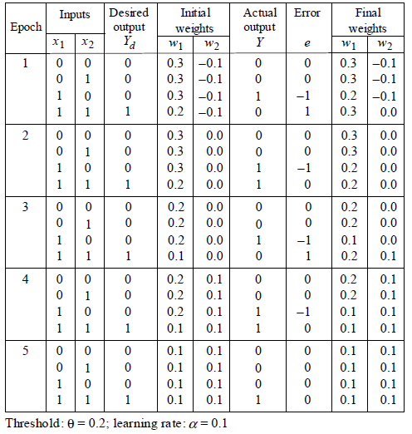
Perceptron for AND logic
This table shows only the weight calculation for next iteration for different random initial weights.

Slide 27
Multilayer neural networks
A multilayer perceptron is a feedforward neural network with one or more hidden layers.
The network consists of an input layer of source neurons, at least one middle or hidden layer of computational neurons, and an output layer of computational neurons.
The input signals are propagated in a forward direction on a layer-by-layer basis.

Slide 28
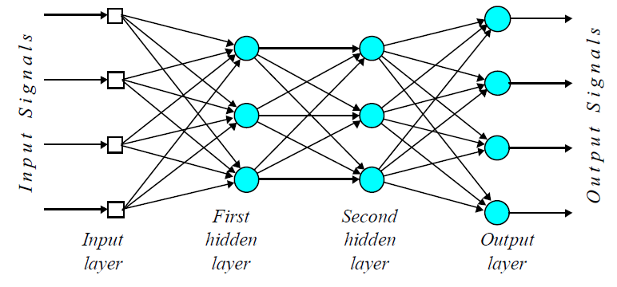
Multilayer perceptron with two hidden layers

Slide 29
Issues in Machine Learning (i.e., Generalization)
What algorithms are available for learning a concept? How well do they perform?
How much training data is sufficient to learn a concept with high confidence?
When is it useful to use prior knowledge?
Are some training examples more useful than others?
What are best tasks for a system to learn?
What is the best way for a system to represent its knowledge?

Slide 30
Opportunities and Challenges
The field of machine learning is quite new, unexplored and rapidly expanding due to new formalizations of the learning problems. For example, many of the algorithms rely on a lot of parameters. Thus an innovative way of tuning them can lead to significant rise in throughput.
There are many more scopes of advancements which involve the learning of natural way of processing things like humans or animals do. However it raises concerns like privacy issues also since it involves manipulation of private data generated by users, which can be a huge security risk. In spite of these insecurities, ML is bounded to be more popular since it allows to solve problems by learning them in place of traditional ways.

